Slide 1
Inventory Management System Overview
Project By:
SH.M.ABDULLAH
M.HASSAN
Date: 3rd December 2024

Slide 2
Introduction
The Inventory Management System is designed to:
Efficiently track stock levels for various items.
Categorize stock as sufficient, low, or overstocked.
Highlight items that require reordering.
Provide financial insights, including retail prices, selling prices, and profit margins.
This project aims to streamline inventory management and ensure optimal stock levels for better decision-making.

Slide 3
Data Summary (PART 1)
The key highlights of the inventory data are:
Total Items: 30
Stock Status:
Sufficient Stock: 18 items
Low Stock: 7 items
Overstocked: 5 item
Reorder Needed: 7 items marked for reorder.

Slide 4
Data Summary (PART 2)
Highest Stock Quantity: 876 (Item: Small roller).
Highest Profit Item: Hing rivet with a profit of 334,000.
Additional Feature:
A VLOOKUP formula is implemented to allow quick retrieval of information.
Entering an Item ID provides details like Item Name, Retail Price, Selling Price, Profit, and Stock Status.

Slide 5
Visual Representation
Stock Quantity
Distribution of Stock Status

Slide 6
Stock Quantity

Slide 7
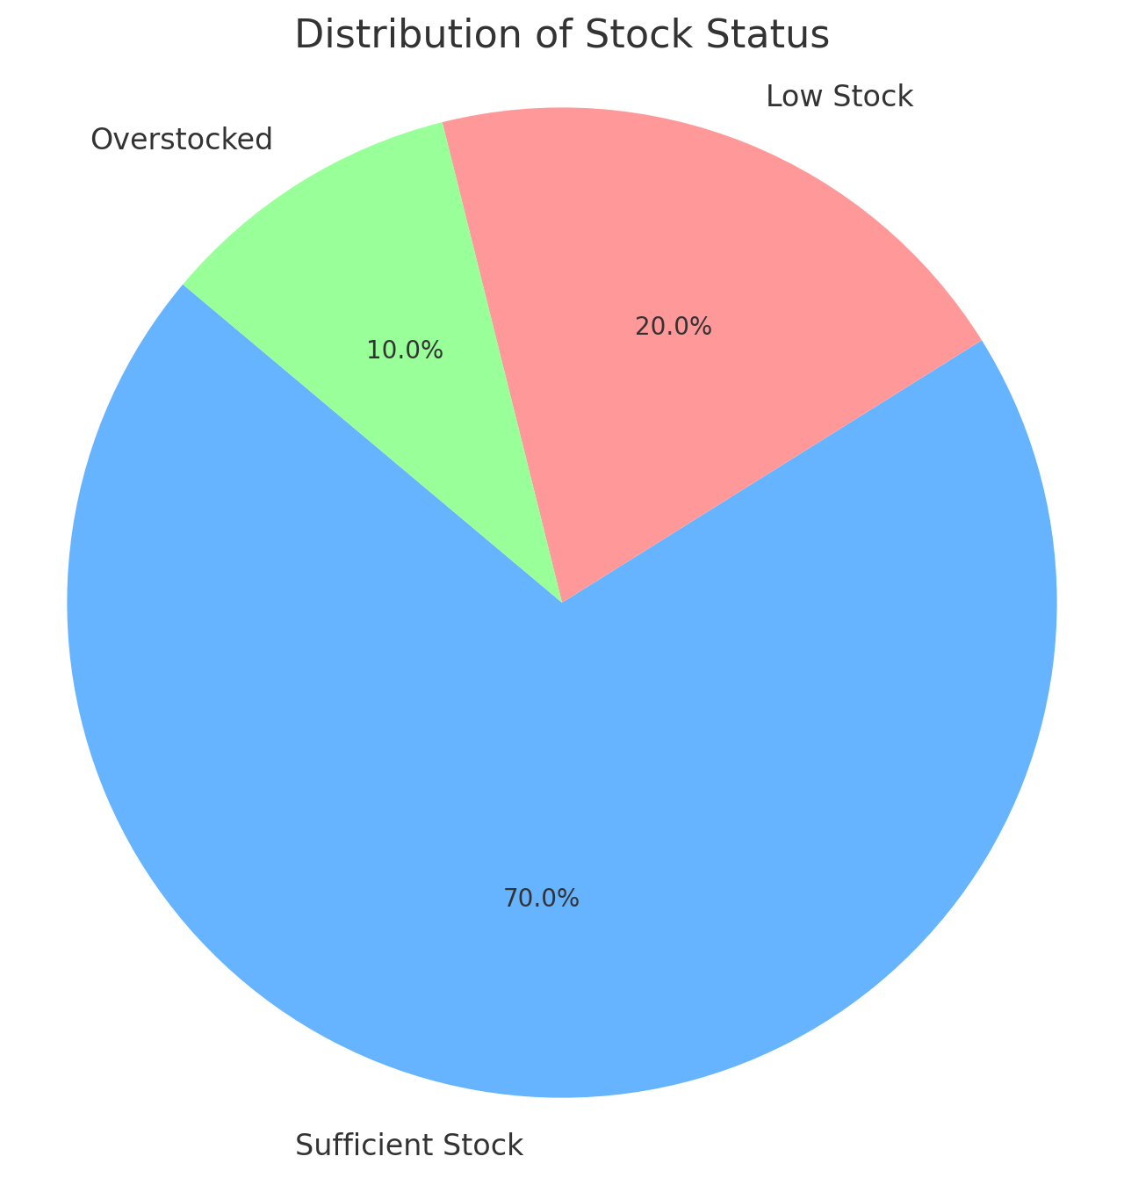
Distribution of Stock Status

Slide 8
Detailed Insights (Part 1)
Top Items by Stock Status:
Sufficient Stock: Majority of items (21 out of 28) are in sufficient stock, ensuring that production and sales are not disrupted.
Low Stock: 6 items are identified as low stock, requiring immediate attention to reorder.
Overstocked: 3 items are overstocked, potentially leading to excess inventory costs.
Top Profit Items:
Highest Profit Item: Hing liver with a profit of 334,000, indicating high sales margins.

Slide 9
Detailed Insights (Part 2)
Items Needing Reorder:
6 items are marked for reorder, mostly falling under the "Low Stock" category. Reordering these items will prevent stockouts and maintain smooth operations.
Actionable Insights:
Focus on restocking low-stock items with high profit potential.
Evaluate overstocked items to reduce excess inventory and free up storage space.
The VLOOKUP formula helps in quickly accessing essential details like item name, price, profit, and stock status, enabling better decision-making.

Slide 10
Conclusion
Key Findings
Recommendations

Slide 11
Key Findings:
The majority of items are in sufficient stock, ensuring efficient operations.
Low stock and overstocked items have been identified, enabling targeted action for stock optimization.
The VLOOKUP formula enhances the system's efficiency by providing quick access to important item details.

Slide 12
Recommendations:
Reorder low-stock items to avoid stockouts and ensure production continuity.
Reduce overstocked items to optimize storage and inventory costs.
Utilize the VLOOKUP tool regularly for better management of stock and financial tracking.

Slide 13
This project provides an efficient system for monitoring and managing inventory to make informed business decisions.
Thank you for your attention!
Please feel free to ask any questions or share your thoughts about the project.

